Slide 1

Lecture 12 The FastSLAM Algorithm
Department of Mechanical Engineering and Automation
Haoyao Chen

Slide 2
Fast SLAM
References
Fastslam: An efficient solution to the simultaneous localization and mapping problem with unknown data association
S. Thrun et. al. (IJCAI 2003)
Fastslam: A Factored Solution to the Simultaneous Localization and Mapping problem with unknown data association
Michael Montemerlo (Thesis 2003)

Slide 3
SLAM
Simultaneous Localization and Mapping problem
Real location
Location with error
Refined location

Slide 4
SLAM
If we have the solution to the SLAM problem…
Allow robots to operate in an environment without a priori knowledge of a map
Open up a vast range of potential application for autonomous vehicles and robot

Slide 5
EKF-based SLAM
Extended Kalman Filter
Prediction
Correction
: Previous value
: Input and measure
: Function
: Computed value

Slide 6
EKF-based SLAM
Assumption
Linear system and Gaussian noise
Example (2D motion)
x : Robot pose
m : Landmark
Setting state vector and covariance matrix

Slide 7
Problems of EKF-based SLAM
Quadratic complexity (scaling problem)
NxN computational complexity

Slide 8
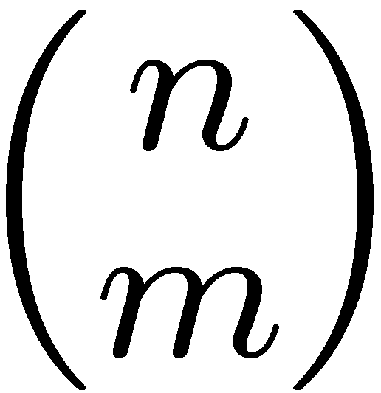
Problems of EKF-based SLAM
- Data Association Problem
A data association is an assignment of observations to landmarks
In general there are more than (n observations, m landmarks) possible associations
Also called “assignment problem”
EKF-SLAM use single hypothesis
Correspondence problem

Slide 9
Modified EKF-based SLAM methods
Quadratic complexity (Scaling problem)
Submap method (Compressed EKF)
Update submap only → constant time
Slow convergence
Suboptimal method
Reduced number of landmark
Divergence problem
Reduced landmark distribution → bad
Etc.

Slide 10
Modified EKF-based SLAM methods
Data association problem
Local Map Sequencing
Corner and line segment (RANSAC)
Joint Compatibility Branch and Bound
Multi hypothesis for observation
Exponential time
Multi Hypothesis Tracking

Slide 11
Fast SLAM
FastSLAM
Features
Particle filter based SLAM
Non-linear, non-Gaussian system can be represented.
Factored solution (for scaling problem)
Faster then EKF-based SLAM
Can treat plenty of landmarks
About 1 million…
Multi-hypothesis (for data association)
Each particle means independent hypothesis.

Slide 12
Fast SLAM
FastSLAM
Posterior Representation
Posterior over maps and robot pose

Slide 13
Fast SLAM
FastSLAM
Factored Posterior Representation
Posterior over maps and robot pose
Posterior over maps and robot path

Slide 14
FastSLAM
Factoring the SLAM problem
If the true path of the robot is known, the position of landmark is conditionally independent of other landmark.
Landmark 1
m₁
z₁
z₃
observations
x₀
x₁
x₂
x₃
. . .
x_{t}
Robot poses
controls
u₀
u₁
u₁
u_{t-1}
z₂
z_{t}
Landmark 2
m₂
Knowledge of the robot’s true path renders landmark positions conditionally independent

Slide 15
FastSLAM
Factored Posterior Representation
Posterior over maps and robot path
Path posterior
Landmark estimators
This factorization is also called Rao-Blackwellization
Given that the second term can be computed efficiently, particle filtering becomes possible!
Robot path posterior (localization problem)
Conditionally independent landmark positions

Slide 16
Advantages of FastSLAM
1. Multi data association ------ Robust
Cope with non-linear robot motion models
------ Accurate
3. Both online and offline SLAM -----only one

Slide 17
Fast SLAM
State Vector has robot pose and landmark position
Each particle has robot pose & Map
Each landmark has it’s own mean and variance and state is solved using EKF
Each particle therefore has to maintain M EKFs
Robot pose
Landmark 1
Landmark 2
Landmark N
Particle 1:
Particle 2:
Particle N:

Slide 18
Basic Algorithm
Do the following M times:
Retrieval. Retrieve a pose from the particle set .
Prediction. Sample a new pose .
Measurement update. For each observed feature identify the correspondence j for the measurement , and incorporate the measurement into the corresponding EKF, by updating the mean and covariance .
Importance weight. Calculate the importance weight for the new particle
Resampling.
Sample, with replacement, M particles, where each particle is sampled with a probability proportional to

Slide 19
Measurement Update
If
If
Using EKF:

Slide 20
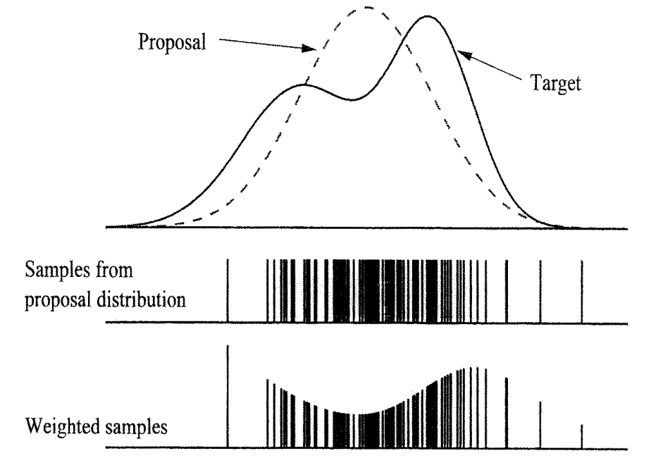
Importance Weight
Importance weight

Slide 21
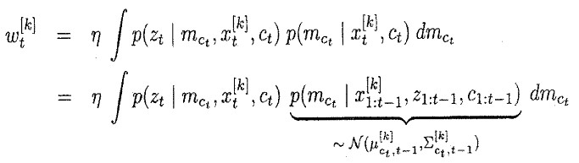
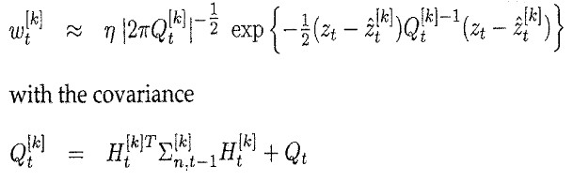
Resampling
Proposal distribution:
Target distribution:

Slide 22
FastSLAM – Action Update
Landmark #1
Filter
Particle #1
Landmark #2
Filter
Particle #2
Particle #3

Slide 23
FastSLAM – Sensor Update
Landmark #1
Filter
Particle #1
Landmark #2
Filter
Particle #2
Particle #3

Slide 24
FastSLAM – Sensor Update
Particle #1
Weight = 0.8
Particle #2
Weight = 0.4
Particle #3
Weight = 0.1

Slide 25
Data Association Problem
Which observation belongs to which landmark?
A robust SLAM must consider possible data associations
Potential data associations depend also on the pose of the robot

Slide 26
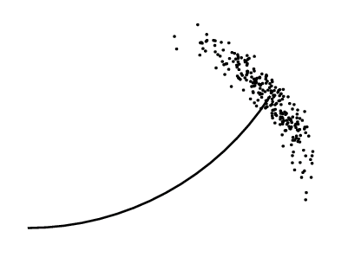
Multi-Hypothesis Data Association
Data association is done on a per-particle basis
Robot pose error is factored out of data association decisions

Slide 27
Per-Particle Data Association
Was the observation
generated by the red
or the blue landmark?
P(observation|red) = 0.3
P(observation|blue) = 0.7
Two options for per-particle data association
Pick the most probable match
Pick an random association weighted by the observation likelihoods
If the probability is too low, generate a new landmark

Slide 28
FastSLAM Complexity
O(N)
Update robot particles based on control u_{t-1}
Incorporate observation z_{t} into Kalman filters
Resample particle set
Constant time per particle
O(N•log(M))
Log time per particle
O(N•log(M))
Log time per particle
N = Number of particles
M = Number of map features
O(N•log(M))
Log time per particle

Slide 29
Fast SLAM
EKF-based SLAM vs FastSLAM
1) EKF-based SLAM 2) PF-based SLAM
- Correction - Selection

Slide 30
Fast SLAM
Experimental Results
Victoria park (for comparison)
Provider : University of Sydney
The vehicle was driven around for approximately 30 minutes, covering a distance of over 4 km.
Ground truth : GPS

Slide 31
Fast SLAM
Experimental Results
Victoria park
Odometry
FastSLAM

Slide 32
Fast SLAM
Experimental Results
Accuracy

Slide 33
Fast SLAM
Experimental Results
Run time (with 100 particles)

Slide 34
Fast SLAM
Experimental Results
Odometry noise (EKF)

Slide 35
Fast SLAM
Experimental Results
Odometry noise (FastSLAM)

Slide 36
Fast SLAM
Experimental Results
Odometry noise (EKFSLAM vs FastSLAM)

Slide 37
Fast SLAM
Conclusion
EKF-based SLAM has problems
Gaussian assumption
High computational complexity
Scaling problem
Data association problem
Single hypothesis
Fast SLAM
Non-Gaussian system
Factored representation and particle filter
Low computational complexity relative to EKF-base SLAM
Multiple hypothesis

